Slide 1

Excel Final Reassessment
Danduprolu Stuthi
4273 - LVADSUSR80
27-03-2024

Slide 2
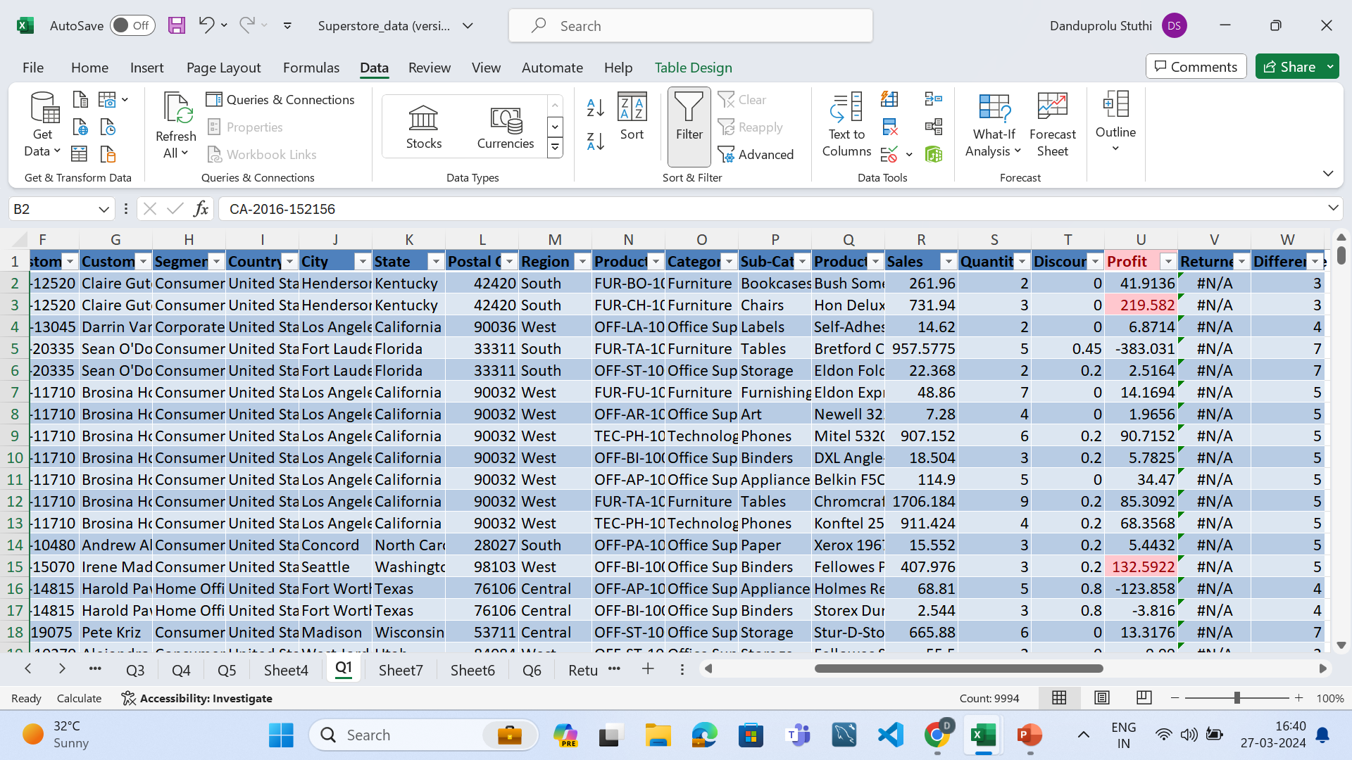
Q1

Slide 3
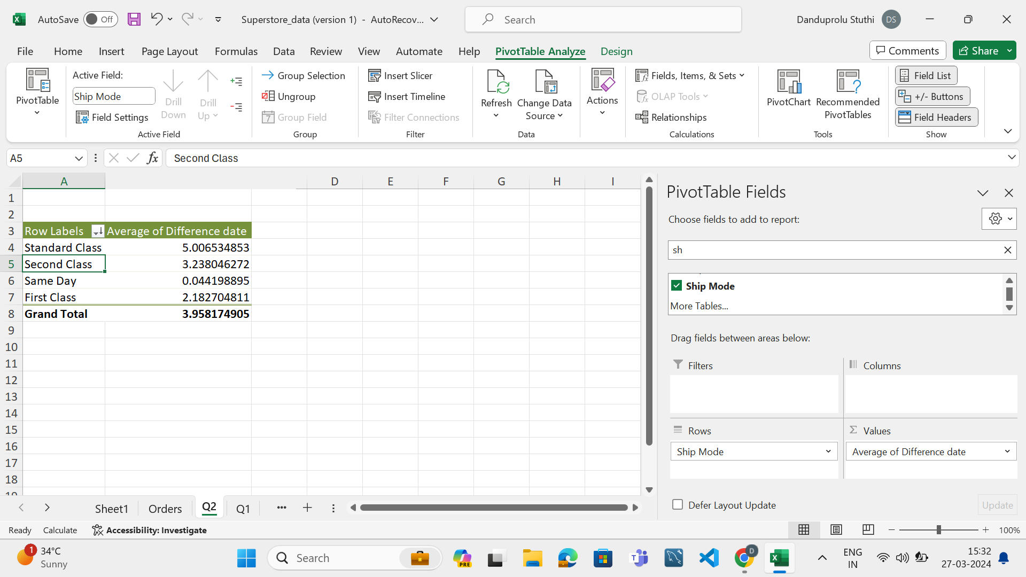
Q2-Shipment analysis
Inference-
Fastest is in standard class
Lowest is in same day

Slide 4
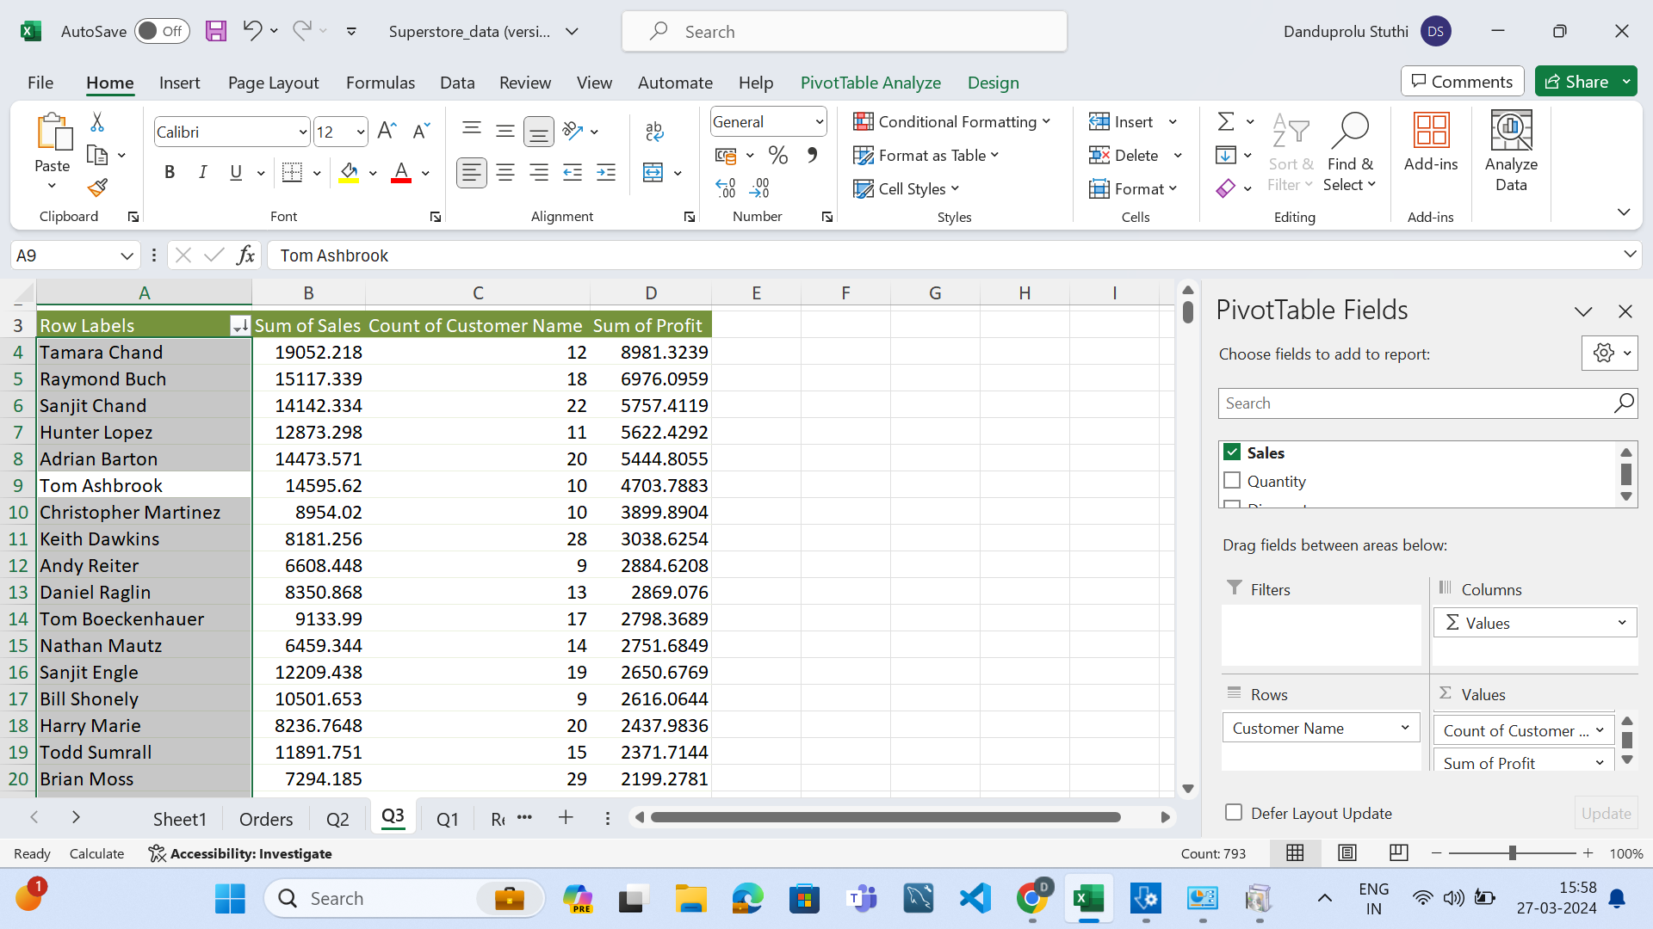
Q3-
Here are the high value customer who are making higher profit for the business

Slide 5
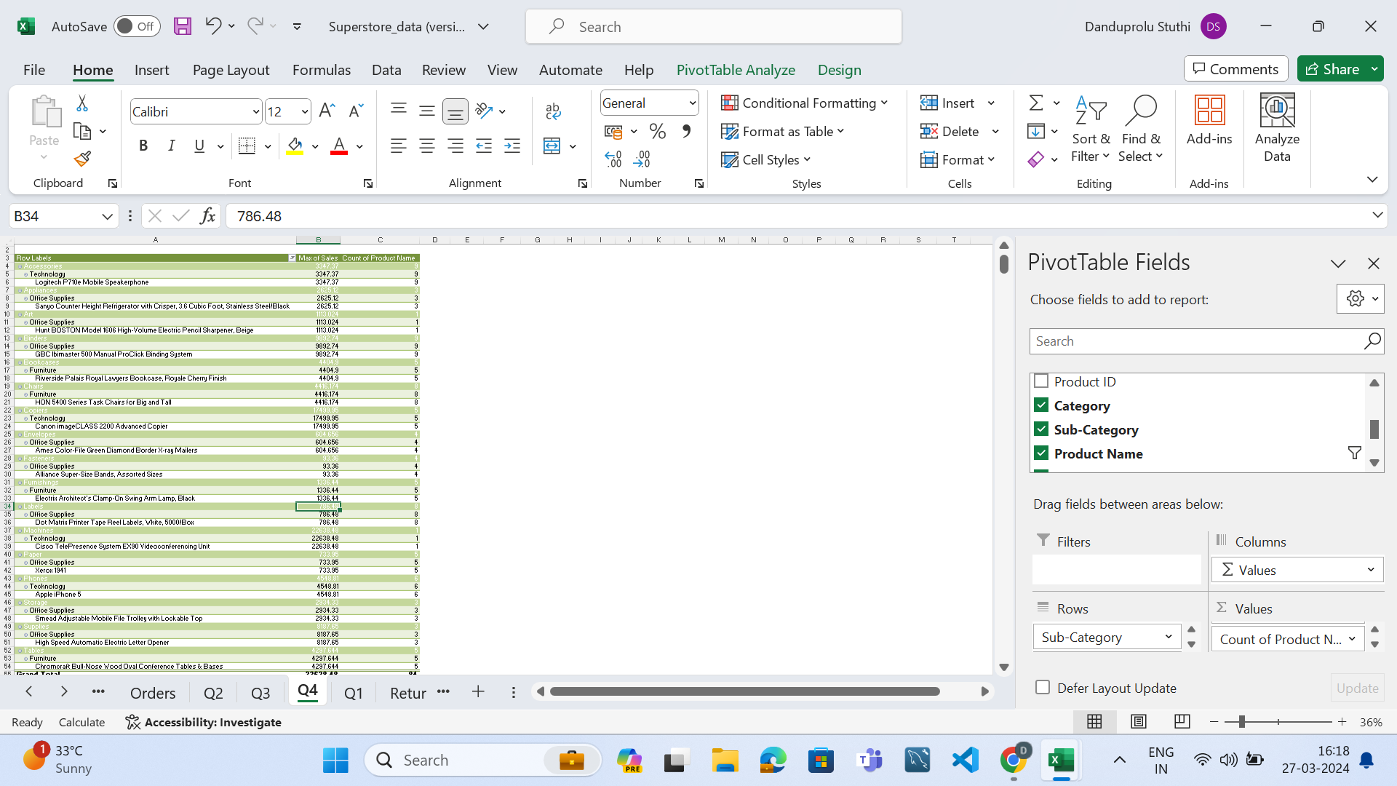
Q4
Therefore we got the all products with count of products in each category and sub -category

Slide 6
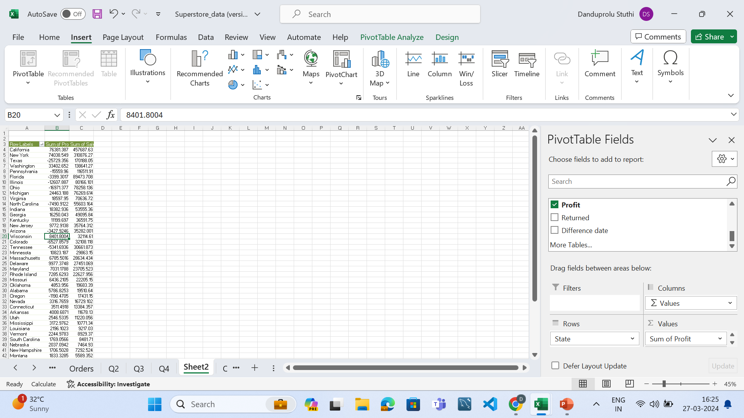
Q5
California has highest sales and North Dakota Has lowest Sales
West region has highest sales
and south region has less Sales

Slide 7
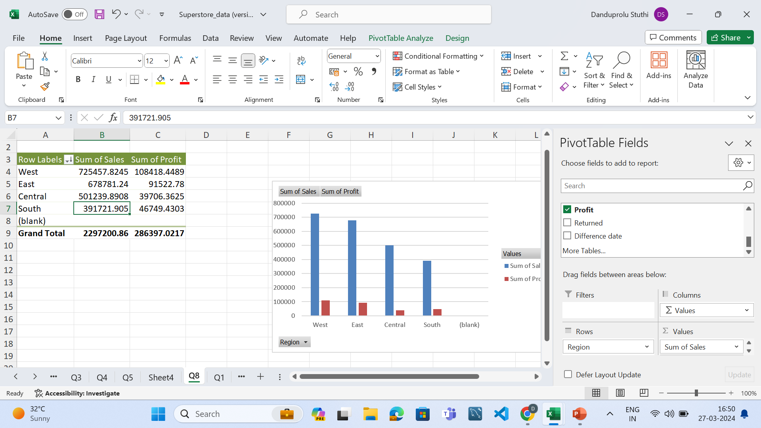
Q5-rest part

Slide 8
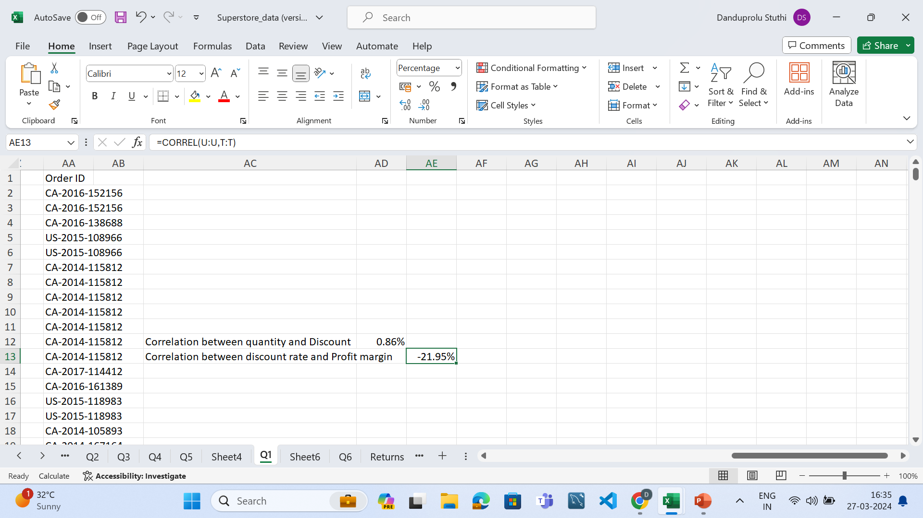
Q6
Correlation Between Discount rate and Quantity is 0.86%
The Correlation between Discount and Profit margin
-21.95%

Slide 9
Q7
West Region has highest growth potential and South region has low Saturation market

Slide 10
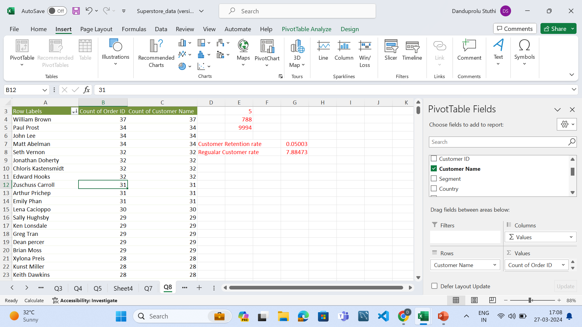
Q8-
Regular Customer Rate 7.88473
Retention Customer Rate
0.05003

Slide 11
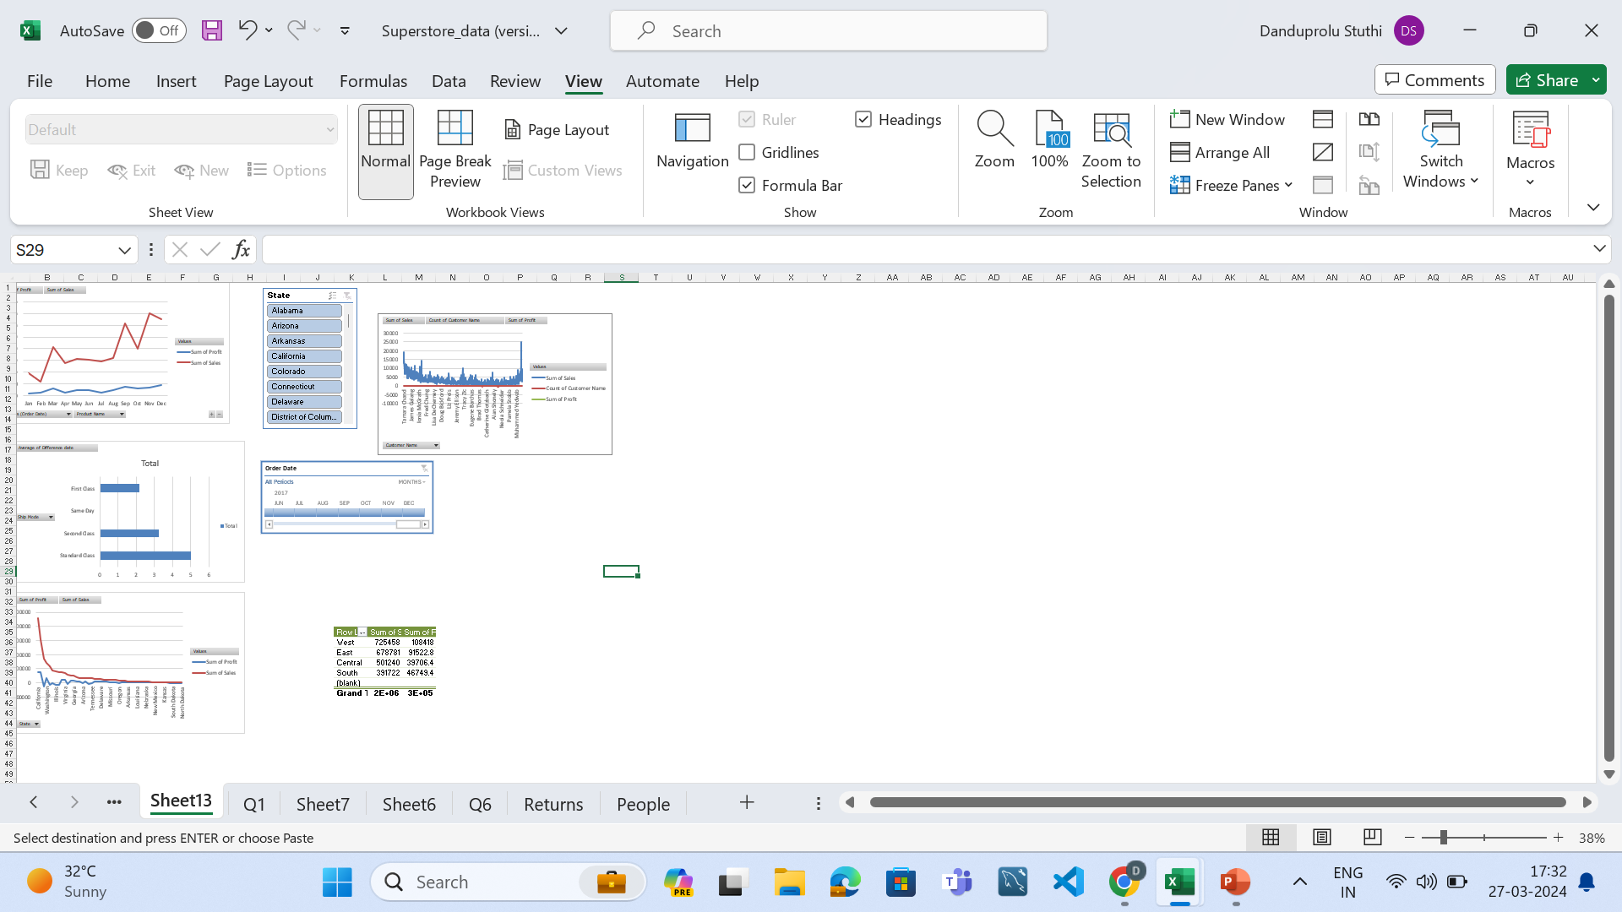
Q9
We can Able to find out the regional basis sales and profit analysis
We are able to analyze on the basis of time sales and profit
We can Able to find out the State basis sales and profit analysis

